Slide 1
W.A.S.P
The best bug tracking tool for your business.

Slide 2
Bug tracking system
A bug tracking system is a web application that keeps track of reported software bugs in software development projects. It may be regarded as a type of issue tracking system.

Slide 3
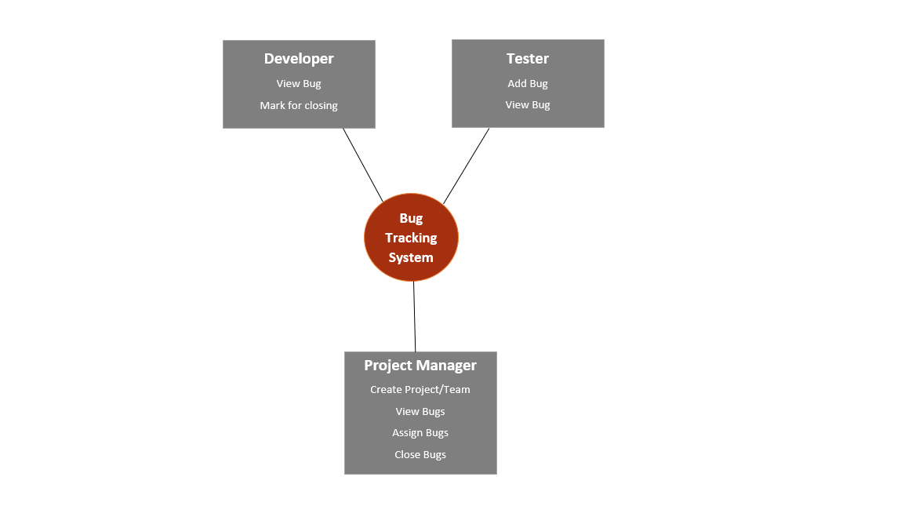

Slide 4
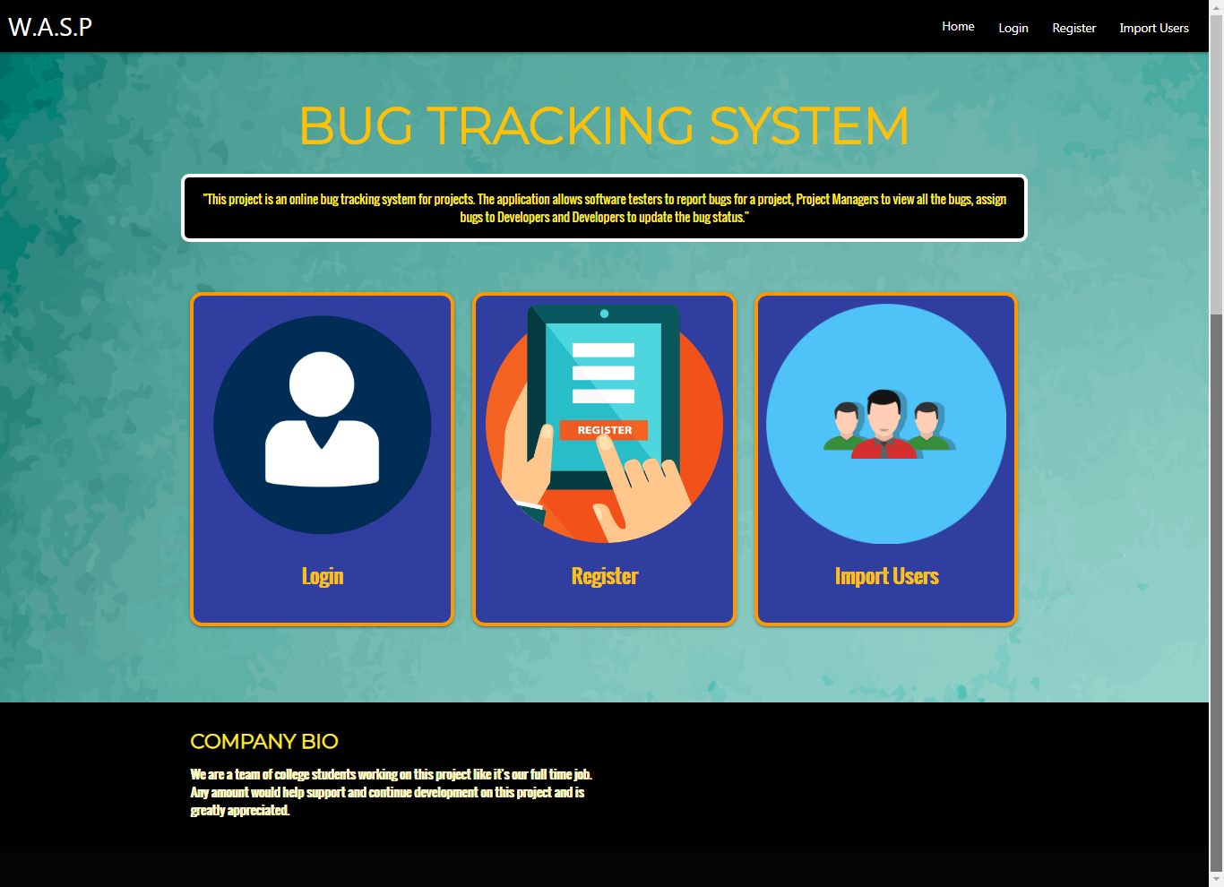

Slide 5
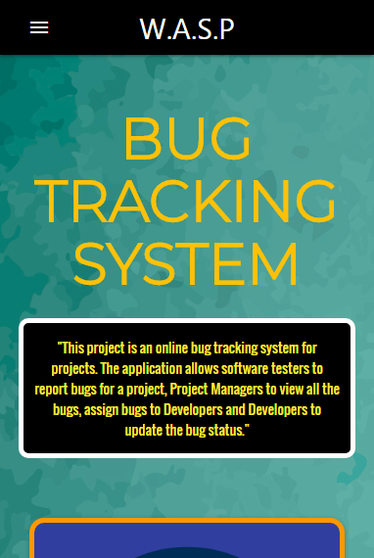
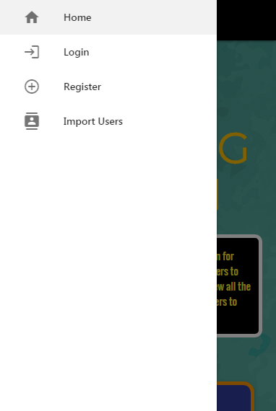
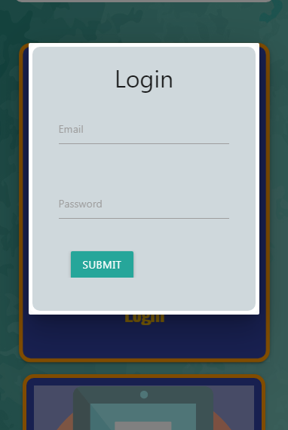

Slide 6
HOME PAGE
Home Page has three responsive cards which directs to their respective forms.
Login
Register
Import User
With Navigation bar, header and footer.
The design is made adaptable to mobile environment as well.

Slide 7
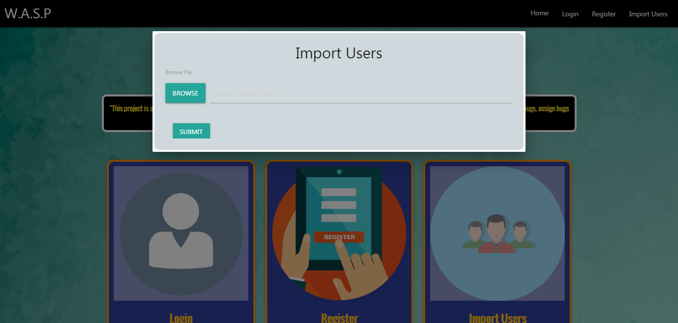

Slide 8
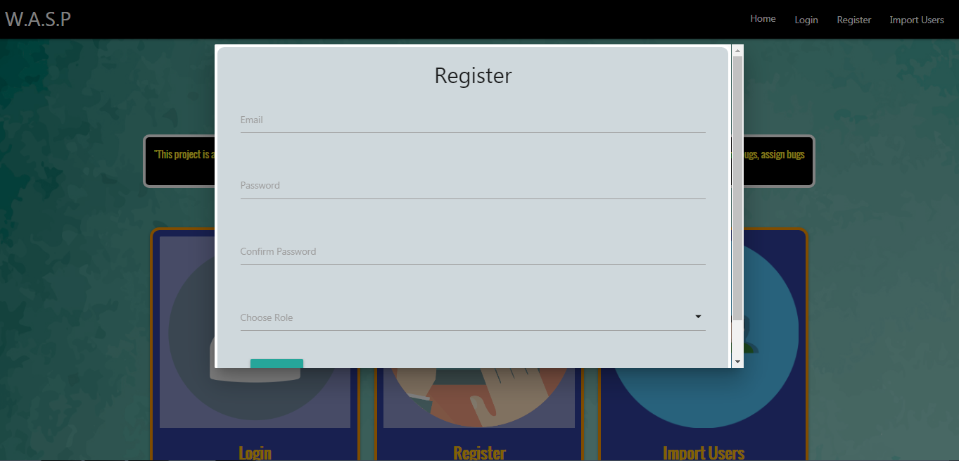

Slide 9
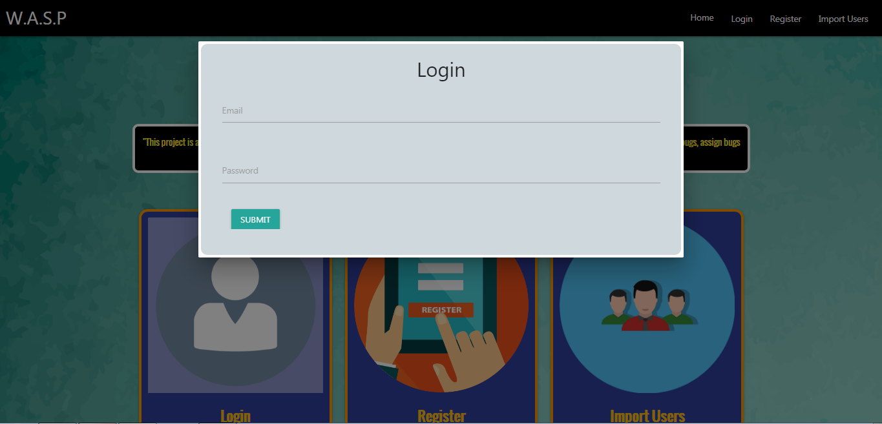

Slide 10
Project manager
This page displays the user information (Email, Role of the user and the last logged in date and time)
It has a link to create a new project which can be done only by a Manager.
It displays a list of all the projects which are under the Manager.
Each project has a link which directs to the page which displays the details of the project.

Slide 11
New project
This page can only be accessed by a Manager to create a new project.
It displays fields such as Project Name, Start date, description and team members of the respective project.

Slide 12
TESTER
This page displays the user information (Name and Email id). If the user is not assigned to any project, it displays a message saying so, else it will show the list of the projects which the user has been assigned to.
It also shows the list of bugs.
It also gives an added functionality to report a new bug.
The page for creating a new bug has fields such as Project name, Title, Description and Severity Level of the bug.

Slide 13
DEVELOPER
This page is displayed only when a developer is logged in.
It has the user information such as Email id and Username.
If the user is assigned to a project, it will display the project name, start date, manager name and list of team members.
Developer can only view the bugs assigned to him.
Developer has an added functionality of marking a bug as closed.

Slide 14
Front-end development
HTML: It describes the structure of the web page, consists of a series of elements and it tells the browser how to display the content.
CSS: It describes how HTML elements are to be styled. We have used a CSS framework which is a modern responsive front-end framework based on Material Design.
JavaScript: It is a light weighted, interpreted compiled programming language. It is prototyped based, multi-paradigm, single threaded and object oriented.

Slide 15
BACK-end development
Servlet: It is used to create a web application (resides at server side and generates a dynamic web page). Servlet technology is robust and scalable because of java language.
JSP: JavaServer Pages are built on top of the Java Servlets API, so like Servlets, JSP also has access to all the powerful Enterprise Java APIs.
JSP pages can be used in combination with servlets that handle the business logic, the model supported by Java servlet template engines.

Slide 16


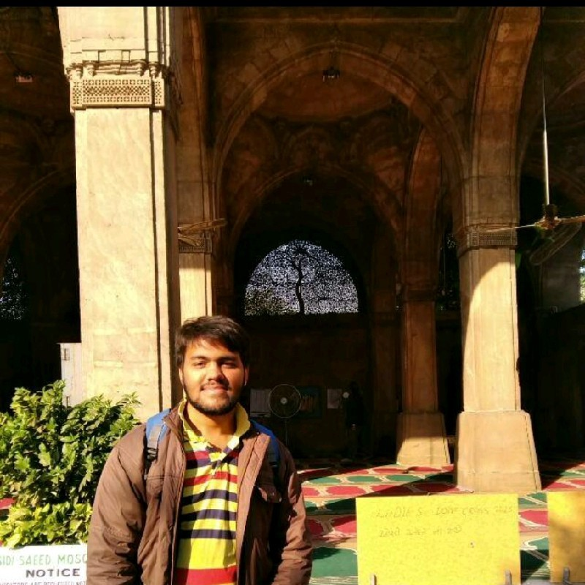




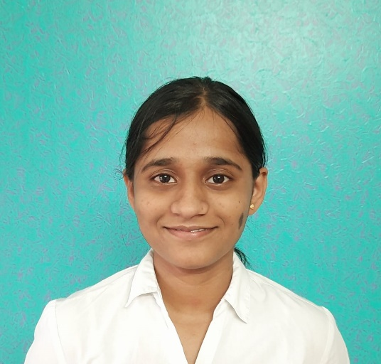
CONTRIBUTORS
Miral Thakkar
Pulkit Bansal
Pankaj Malik
Vineet Kishore
Megha Garg
Liza Stephen
Aditya Samota
Shriya Tambare

Slide 17
PROJECT LEarnings
Frontend development:
HTML
Materialize CSS
Javascript
JQuery
Backend development:
Java- Servlets and JSP
Apache Tomcat Server
JSON
Database:
Derby

Slide 18
Business learnings
Effective communication
Teamwork
Collaboration
Scrum methodology
Regular feedback and analysis
Constructive criticism
Resource management

Slide 19
COLLABORATION
We setup a schedule for regular Zoom meetings, to plan our goals and update the status of the project.
We used Github to share our source code which helped to reduce our time in repetitive tasks by a great extent.
We used Google docs to collaborate for documentation purpose.
And lastly Whatsapp for quick chats.
Obviously, nothing can replace human touch but these tools helped a lot to bridge the gap within the team.

Slide 20
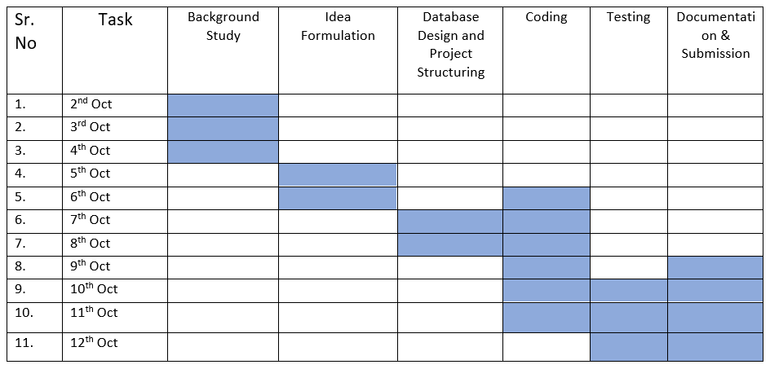
Project timeline

Slide 21


